Slide 1
RPR Titration Tips
NewBio

Slide 2
Assay Procedure
Place 50µl of sample into a circle marked on the test card.
Spread the sample evenly over the test circle area. The flat end of the pipstirs can be used to spread the sample over the test circle.
Shake the vial of RPR antigen to ensure even mixing.
Attach the dropping needle to the plastic dropping bottle and take up the RPR antigen by suction.
Invert the dropping bottle containing antigen and gently squeeze to expel air from the needle.
Holding the dropper bottle vertically over the test sample dispense a single drop (~17.5µL) of antigen.
Place test card on a card rotator and rotate at 100 RPM for 8 minutes.
Read and interpret results visually in good light. See interpretation in IFU.
It is recommended that the Kit Positive and Negative controls are run with each batch of test samples.
Return any unused antigen from dropper bottle to the glass vial.
Clean out dropper bottle and needle with distilled water and allow to dry before reusing.

Slide 3
Sample Titration Procedure
Make doubling dilutions from undiluted to 1:16 in normal saline.
Place 50µL of each dilution into a separate circle on the test card.
Spread each dilution evenly over the test circle.
Continue as from Assay Procedure above.
The titre is expressed as the final dilution which shows aggregation of the carbon particles.
Notes:
Summarize your research in three to five points.

Slide 4
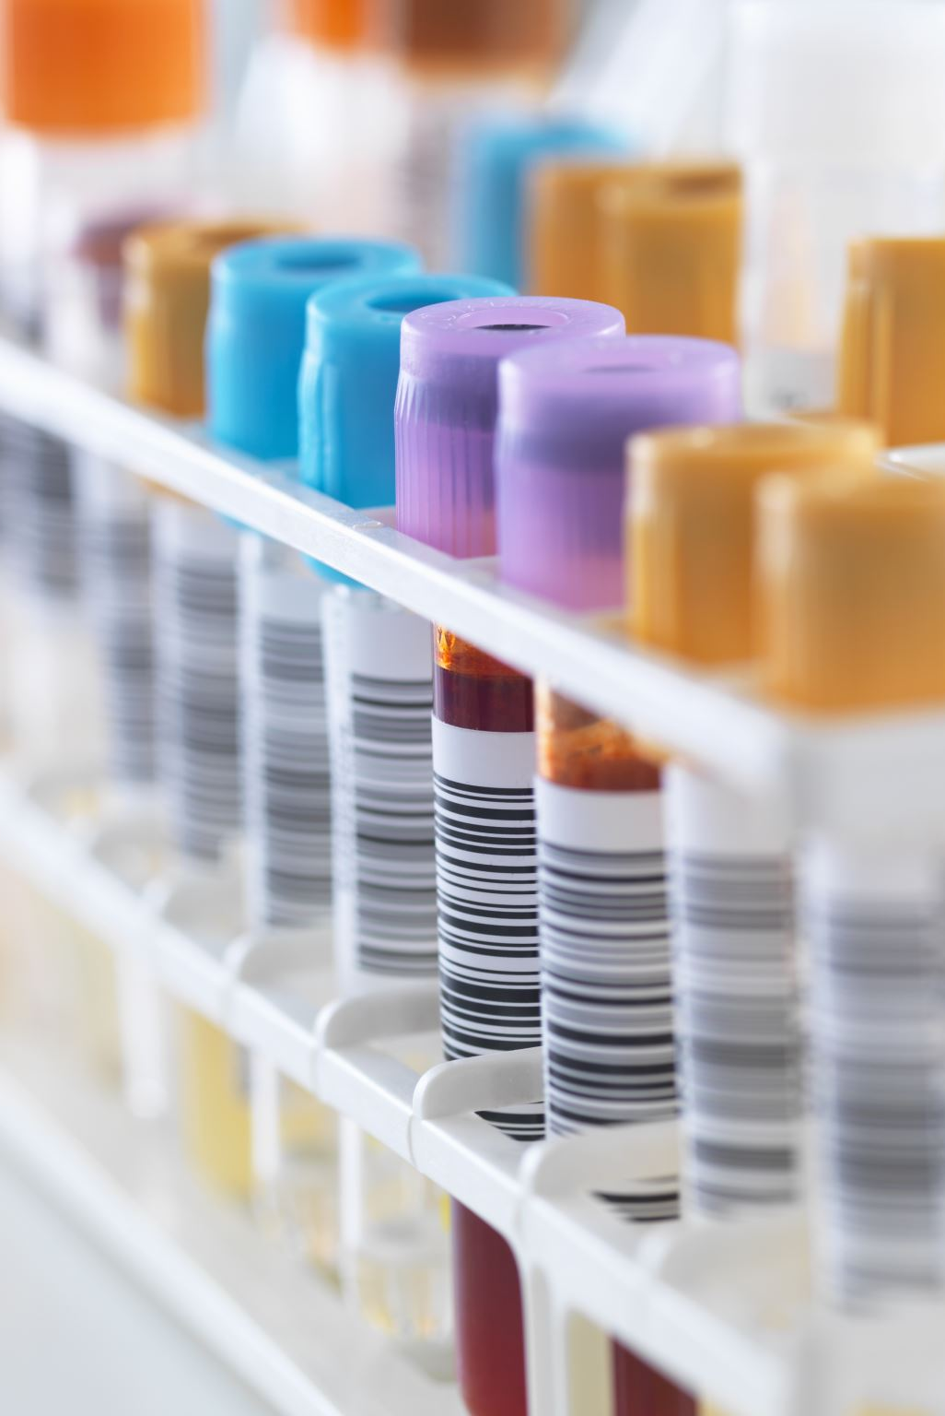
Control Procedure
The Positive and Negative Controls must be run with each assay. Additional QC testing may be performed by the operator by the inclusion of other characterised specimens or reference material.
The Positive Control should produce a positive result and the Negative Control should produce a negative result with the test. If the appropriate results are not obtained with the controls, the assay is considered invalid and all samples within that assay should be retested.

Slide 5
Titration Scheme for Patient sample
Tube # | 1 | 2 | 3 | 4 | 5
Diluent | N/A | 50µL | 50µL | 50µL | 50µL
Serum | 50µL | 50µL | 50µL | 50µL | 50µL
50µL
50µL
50µL
50µL
Tube # | 1 | 2 | 3 | 4 | 5
Serum Dilution | 1:1 | 1:2 | 1:4 | 1:8 | 1:16

Slide 6
Interpretation of Results
Strong Reactive: Large clumps of carbon particles with a clear background
Reactive: Large clumps of carbon particles somewhat more disperse than Strong Reactive
Weak Reactive: Small clumps of carbon particles with light grey background
Trace Reactive: Slight clumping of carbon particles typically seen as a button of aggregates in the centre of the test circle or dispersed around the edge of the test circle.
Non Reactive: Typically a smooth grey pattern or a button of non aggregated carbon particles in the centre of the circle.

Slide 7

Further Reading
www.newbio.com

